Slide 1


Slide 2
Using your Web Browser,
Open this URL:
Click on the workshop you’re attending, and find:
1
http://mlhlocal.host/lhd-resources
2
Setup Instructions
The Code Samples
A demo project
A Workshop FAQ
These Workshop Slides
More Learning Resources
Notes:
What to Say:
Tell attendees we are going to check them in for the event
Once attendees check in, they will receive an email with the items listed on the slide
Attendees must check-in to get credit for attending this event
What to Do:
Confirm that everyone has checked in by asking participants to give you a signal when they receive the email.

Slide 3

Our Mission is to Empower Hackers.
65,000+
HACKERS
12,000+
PROJECTS CREATED
3,000+
SCHOOLS
We hope you learn something awesome today!
Find more resources: http://mlh.io/
Notes:
What to Say:
Major League Hacking (MLH) events are meant to bring hackers together so they can learn, build, and share.
Give participants a brief overview of Major League Hacking (MLH).
Tell participants they can learn more at http://mlh.io/
Example Talking Points:
Through Localhost MLH is rethinking technology education to reflect how hackers actually learn and how fast the industry moves.
Here’s some quick facts about MLH:
Each year, MLH supports over 65,000 hackers around the world at events they facilitate
Those students create more than 12,000 amazing projects together
MLH is a global organization that empowers hackers in more than 400 cities and growing every day

Slide 4
Presented in partnership by
Citrix powers a better way to work by delivering the experience, security and choice that people and organization need to unlock innovation, engage customers, and be productive – anytime, anywhere.
Their Digital Workspaces combine the apps and files needed to get work done, with access control and endpoint management that offer the contextual, secure, unified experiences organization need to do their best work.
Learn about Citrix Career Opportunities!
http://mlhlocal.host/citrix-careers
Notes:
What to Say:
Talk about Citrix, the presenting company of the module.
They are hiring hackers! Point students to the career page

Slide 5
What will you learn today?
1
Best practices for technical interviews.
2
How to solve several common technical interview questions.
3
Where to go for more practice.
Notes:
What to Say:
Explain to participants what they will learn today
Learning is a core part of being a hacker and today they are going to learn something new
What to Do:
Get participants excited about the experience.

Slide 7

Technical Interview Tips
Tip #1: It is OK to ask questions!
Begin by asking parameter questions - they really want to see that you think about what you're doing before you begin coding. For example, if you're asked to reverse a string, ask if there are any built-in methods that you aren't allowed to use (like reverse()).
Notes:
What to Say:
What to Do:
Read the slide

Slide 8

Technical Interview Tips
Tip #2: Plan your answer before you begin coding or whiteboarding.
Say things like "The first thing this function needs to do is . . ." It's ok to write some things down or make notes to yourself! They want to see you planning.
Notes:
What to Say:
What to Do:
Read the slide

Slide 9

Technical Interview Tips
Tip #3: Start coding or whiteboarding, and talk through parts where you're stuck.
Technical interviewers know what they can and can't share with you. They're very likely to give you a hint if you're close (like if can't remember the name of the method you want to use).
Notes:
What to Say:
What to Do:
Read the slide

Slide 10

Technical Interview Tips
Tip #4: It's important to refactor!
Once you're satisfied with the way your function works, pause and think about how you can refactor. Remember to talk through what you're doing! Say "I want to refactor this line, because . . . "
Notes:
What to Say:
Ask if anyone can explain what refactoring means.
Ask if anyone knows any refactoring strategies.
What to Do:
Read the slide

Slide 11

Technical Interview Tips
Tip #5: Explain your answer thoroughly when you've finished.
Some companies actually place a higher value on your ability to explain how your answer works and why you made the choices that you did than the answer itself. Talk about what your solution does, why you chose this over that, etc.
Notes:
What to Say:
What to Do:
Read the slide

Slide 12

Technical Interview Tips
Tip #6: Watch the time.
Break the time down. You want to give yourself something like this:
10% to plan
50% to implement
20% to refactor
20% to discuss
Notes:
What to Say:
What to Do:
Read the slide

Slide 13

Technical Interview Tips
To Recap:
It is OK to ask questions!
Plan your answer before you begin coding or whiteboarding.
Talk through the parts where you're stuck.
It's important to refactor!
Explain your answer thoroughly when you've finished.
Watch the time.
Notes:
What to Say:
What to Do:
Read the slide

Slide 15
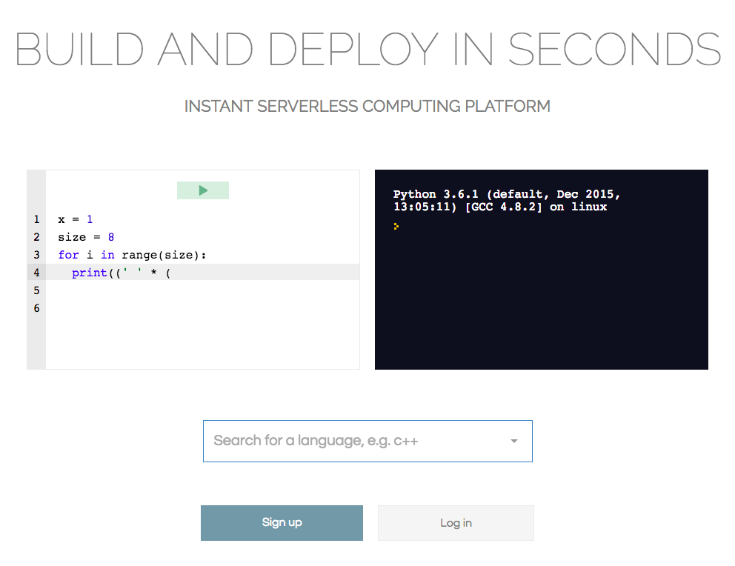
repl.it
As you work through some of these problems, you might want to check your solutions. While you might not be able to do this in a formal interview, during practice it's a great idea to use a tool like repl.it to debug or share your code!
Notes:
What to Say:
The question may be slightly different, such as instead of writing a function that takes an input, you might write a function that prints from 1 to 100.
What to Do:
Read the slide. Allow the GIF to play a few times.
Note - some people say "reppel-it" and some say "reppel dot i t." Either way is probably fine.

Slide 16
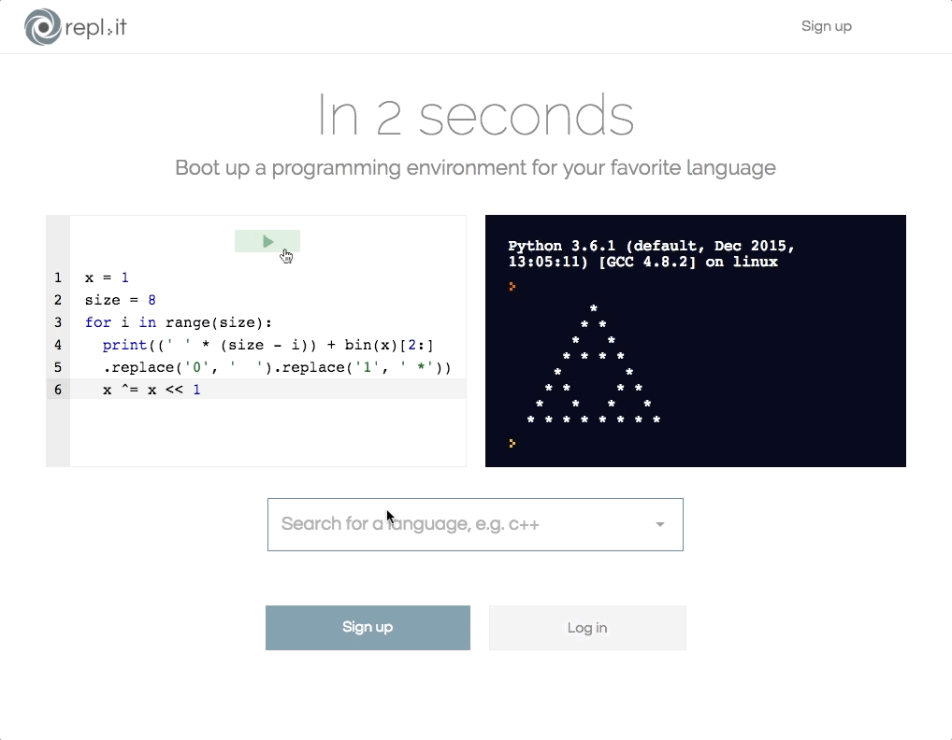
Step 1: On repl.it, search for the language you want to use.
Notes:
What to Say:
Repl.it offers tons of different languages and gets you started in a properly configured coding environment super quickly.
What to Do:
Read the slide. Allow the GIF to play a few times.

Slide 17
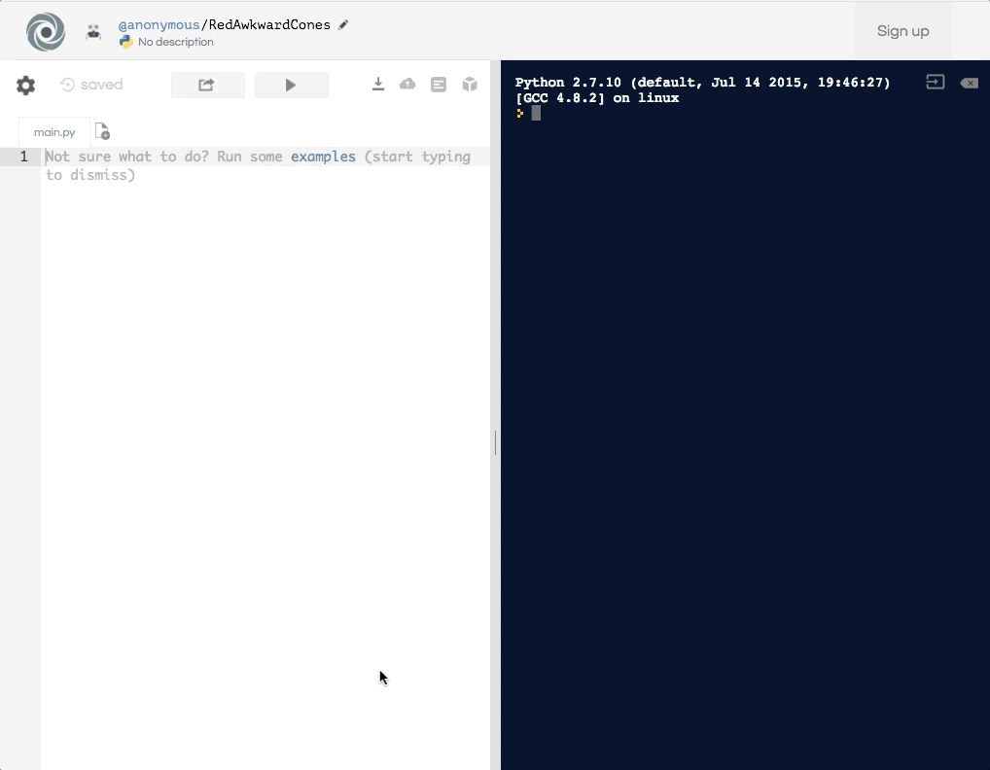
Step 2: Type your solution in the code editor on the left.
Notes:
What to Say:
What to Do:
Read the slide. Allow the GIF to play a few times.

Slide 18
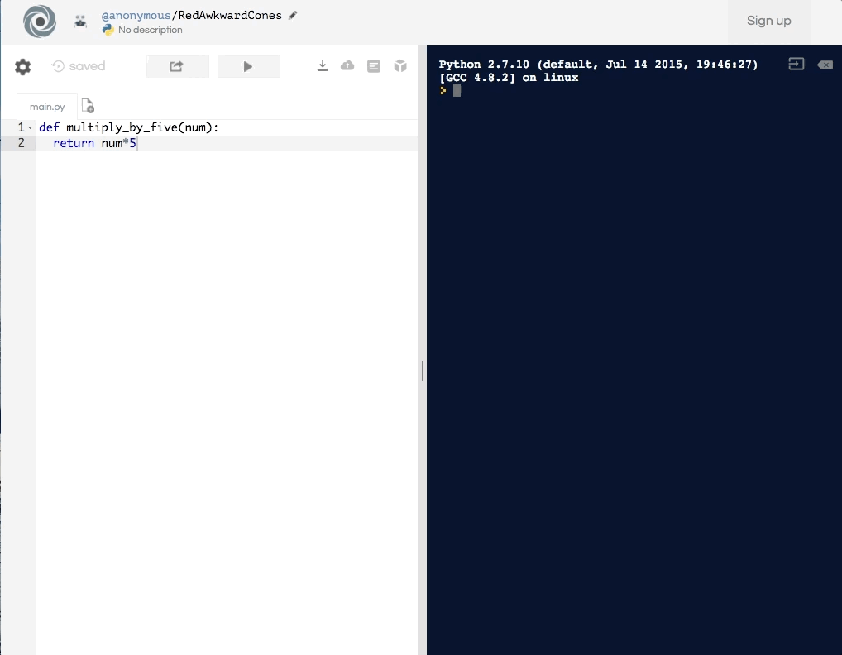
Step 3: Call your function and click the Run button.
Notes:
What to Say:
If your solution is correct, you'll see the desired output in the console on the right.
Otherwise, you can use the output (errors, return values, etc) to debug your code!
Depending on how your write your function, you may need to include a "print" statement in front of your function call.
What to Do:
Read the slide. Allow the GIF to play a few times.

Slide 19
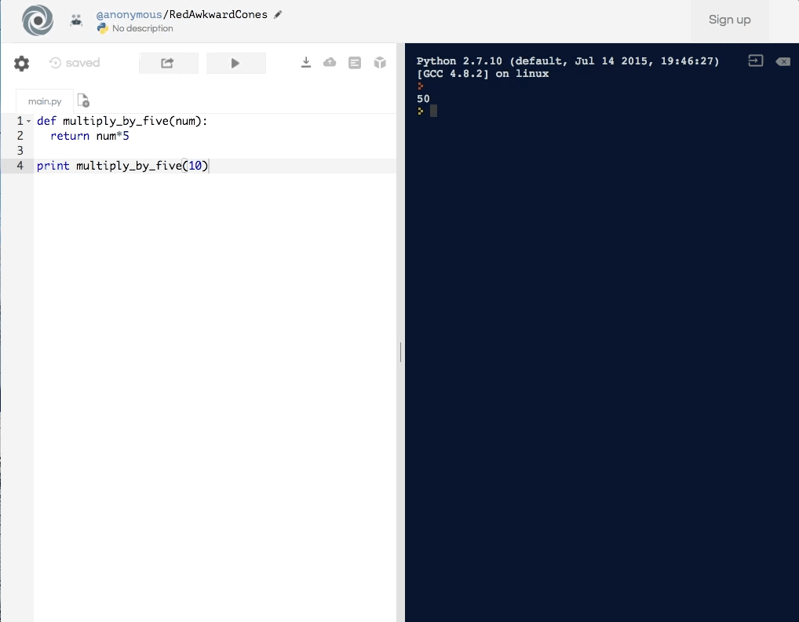
Step 4: To share a solution later, tell the presenter the name at the end of the URL.
Notes:
What to Say:
It's not necessary to use repl.it at any point throughout this workshop. However, if you want to use it to try your solutions and debug your code, it's a great tool! It's also really useful for sharing your solutions with other people.
What to Do:
Read the slide. Allow the GIF to play a few times.

Slide 20
Let's do a Practice Problem!
Problem Statement:
Example Output:
Write a function that takes a single input, a number, and prints out 1 through the number. If the number being printed is divisible by 3, print "Fizz" instead of the number itself. If the number being printed is divisible by 5, print "Buzz." If the number being printed is divisible by 3 AND 5, print "FizzBuzz."
01
02
03
04
05
06
07
08
09
10
11
12
13
14
15
16
17
1
2
Fizz
4
Buzz
Fizz
7
8
Fizz
Buzz
11
Fizz
13
14
FizzBuzz
16
. . .
Pro-Tip: Take a picture of this problem to refer back to.
Notes:
What to Say:
FizzBuzz is a simple problem that many interviewers and recruiters use in initial phone screens or other early interview stages as a quick "gut check" to see if you have any programming experience. Many developers still get this one wrong!
What to Do:
Read the slide completely, especially the tip about taking a picture. Give attendees a minute to pull the slides up from their email or take a picture of the problem.

Slide 21

Tip #1: Ask questions!
What are some questions you might ask before solving this problem? Share example questions.
Notes:
What to Say:
Questions might include:
Should the function account for whether the input is not a number? (type-checking)
Should the function return anything?
Should the function work for negative numbers?
What to Do:
Encourage participants to raise their hands and engage!

Slide 22
Tip #2: Plan your answer.
This is called pseudocode. We wrote out exactly what we want the function to do in plain language. Later we can "translate" these steps into the coding language of our choice.
01
02
03
04
05
06
07
08
09
10
11
12
## function should take one parameter
## then check if the element is divisible by 3 ## if yes, print "Fizz"
## otherwise, check if the element is divisible by 5
## if yes, print "Buzz"
## otherwise, check if the element is divisible by both 3 && 5
## if yes, print "FizzBuzz"
## otherwise, print the number itself.
Notes:
What to Say:
This is not the only way to plan your answer.
Also, you can do this with pencil and paper, on a whiteboard, or by explaining out loud.
What to Do:
Ask if anyone would like to explain psuedocode. Then read the slide.

Slide 23
Tip #3: Write out your solution.
This solution translates the pseudocode from the last slide into a function, step-by-step. This solution is in Python, but the language doesn't matter.
01
02
03
04
05
06
07
08
09
10
11
12
def fizz_buzz(num): for x in range(1, num+1): if x % 3 == 0: print('Fizz') elif x % 5 == 0: print('Buzz')
elif x % 3 == 0 and x % 5 == 0: print('FizzBuzz') else: print(x)
Notes:
What to Say:
Here's a solution that translates the steps into Python.
On the next slide, we'll use repl.it to check this solution!
What to Do:
Read the slide and allow participants to read the code for themselves.

Slide 24

Let's check our solution!
Notes:
What to Say:
What to Do:
Play the video. Let participants think about it.
Ask participants if they can see what went wrong. (The function never prints "FizzBuzz"),

Slide 25
Tip #4: It's important to refactor.
Did you see what went wrong in the video on the previous slide? This is why you talk through your code and refactor!
Notes:
What to Say:
In this control flow structure, the function checks if the current number is divisible by 3. If it is, the program prints Fizz and moves on to the next number. If a number is divisible by 3 AND 5, it never makes it to the final check, so it will never print FizzBuzz.
What to Do:
Read the slide.
Play the video.

Slide 26
Tip #5: Explain your answer.
Line 1 defines a function with a single parameter.
01
02
03
04
05
06
07
08
09
10
11
12
def fizz_buzz(num): for x in range(1, num+1): if x % 3 == 0 and x % 5 == 0: print('FizzBuzz') elif x % 3 == 0: print('Fizz') elif x % 5 == 0: print('Buzz') else: print(x)
Notes:
What to Say:
What to Do:
Ask if anyone would like to talk through the solution. If not, explain it yourself or read the slides to explain it step by step.
If you choose to explain it yourself, you can skip slides 31-35.

Slide 27
Tip #5: Explain your answer.
Line 3 creates a loop that will iterate from 1 through the number passed through the function.
01
02
03
04
05
06
07
08
09
10
11
12
def fizz_buzz(num): for x in range(1, num+1): if x % 3 == 0 and x % 5 == 0: print('FizzBuzz') elif x % 3 == 0: print('Fizz') elif x % 5 == 0: print('Buzz') else: print(x)
Notes:
What to Say:
What to Do:
Ask if anyone would like to talk through the solution. If not, explain it yourself or read the slides to explain it step by step.
If you choose to explain it yourself, you can skip slides 31-35.

Slide 28
Tip #5: Explain your answer.
Line 4 checks if the current value is divisible by both 3 and 5.
Line 5 prints "FizzBuzz" if that's true.
01
02
03
04
05
06
07
08
09
10
11
12
def fizz_buzz(num): for x in range(1, num+1): if x % 3 == 0 and x % 5 == 0: print('FizzBuzz') elif x % 3 == 0: print('Fizz') elif x % 5 == 0: print('Buzz') else: print(x)
Notes:
What to Say:
What to Do:
Ask if anyone would like to talk through the solution. If not, explain it yourself or read the slides to explain it step by step.
If you choose to explain it yourself, you can skip slides 31-35.

Slide 29
Tip #5: Explain your answer.
Line 6 checks if the current value is divisible by only 3.
Line 7 prints "Fizz" if that's true.
01
02
03
04
05
06
07
08
09
10
11
12
def fizz_buzz(num): for x in range(1, num+1): if x % 3 == 0 and x % 5 == 0: print('FizzBuzz') elif x % 3 == 0: print('Fizz') elif x % 5 == 0: print('Buzz') else: print(x)
Notes:
What to Say:
What to Do:
Ask if anyone would like to talk through the solution. If not, explain it yourself or read the slides to explain it step by step.
If you choose to explain it yourself, you can skip slides 31-35.

Slide 30
Tip #5: Explain your answer.
Line 8 checks if the current value is divisible by only 5.
Line 9 prints "Buzz" if that's true.
01
02
03
04
05
06
07
08
09
10
11
12
def fizz_buzz(num): for x in range(1, num+1): if x % 3 == 0 and x % 5 == 0: print('FizzBuzz') elif x % 3 == 0: print('Fizz') elif x % 5 == 0: print('Buzz') else: print(x)
Notes:
What to Say:
What to Do:
Ask if anyone would like to talk through the solution. If not, explain it yourself or read the slides to explain it step by step.
If you choose to explain it yourself, you can skip slides 31-35.

Slide 31
Tip #5: Explain your answer.
Line 12 prints the number itself if none of the previous conditions were met.
01
02
03
04
05
06
07
08
09
10
11
12
def fizz_buzz(num): for x in range(1, num+1): if x % 3 == 0 and x % 5 == 0: print('FizzBuzz') elif x % 3 == 0: print('Fizz') elif x % 5 == 0: print('Buzz') else: print(x)
Notes:
What to Say:
What to Do:
Ask if anyone would like to talk through the solution. If not, explain it yourself or read the slides to explain it step by step.
If you choose to explain it yourself, you can skip slides 31-35.

Slide 32
Tip #6: Watch the time!
How long did that take? Do you think we split up our time efficiently? Did we hit all the steps?
Remember, you want to give yourself something like this:
10% to plan
50% to implement
20% to refactor
20% to discuss
Notes:
What to Say:
What to Do:
Read the slide.
Ask participants if they're ready for their first challenge!
Give participants a minute to write this down or take notes if they want.

Slide 34
How This Works
Make sure you have a partner!
Two problems will be presented. Each problem has an Interviewer Script. One person should be the interviewer and the other person should be the candidate. Switch places for the second problem.
The URL to find the Interview Script is on the slide with the problem statement. The interviewer should pull it up on their phone or laptop.
Notes:
What to Say:
You can solve the problems in whatever language you prefer, but for this workshop solutions will only be presented in Python.
What to Do:
Read the slides.
Wait for everyone to partner up. If there is an odd number of people, you can decide if you want to work with someone or allow groups of 3.
It's important for people to work together!

Slide 35

How This Works
Once the problem is up on the board, do your best to treat it like a real interview! Follow the tips we've covered so far.
When time is up, we'll review some solutions together on the board.
Be brave! Share your solutions.
Notes:
What to Say:
What to Do:
Read the slide.
Make sure everyone has a partner.
Ask if there are any questions about how the process works.
Make sure everyone has decided who will be the interviewer and who will be the candidate for the first problem.

Slide 36
String Rotation
Write a function that takes in two string inputs, and returns true if they are a rotation of each other.
Time: 35 minutes
01
02
03
04
05
06
07
08
09
10
11
12
## input
rotate(“ABCD”, “BCDA”)
## output
TRUE
## input
rotate(“ABCD”, “ACDB”)
## output
FALSE
01
02
03
04
05
06
07
08
09
Notes:
What to Say:
Any questions that you have about these problems should be answered in the interviewer script.
If the answer is NOT in the interview script, the interviewer gets to decide the correct answer and the candidate should treat it as fact.
What to Do:
Read the slide.
Ask if everyone is ready to begin.
Keep time! If you are not diligent about the time, it will absolutely run over, especially if participants are stuck.

Slide 37

Time's Up!
Does anyone want to share their solution?
Share your repl.it URL and then we'll discuss!
Max time: 5 minutes
Notes:
What to Say:
Time's up! Let's share some solutions.
What to Do:
Ask if anyone wants to share their solution.
If they do, open another browser tab and navigate to the URL they share with you.
Encourage them to explain their solution and for participants to discuss!
Max time per solution: 5 minutes.

Slide 38
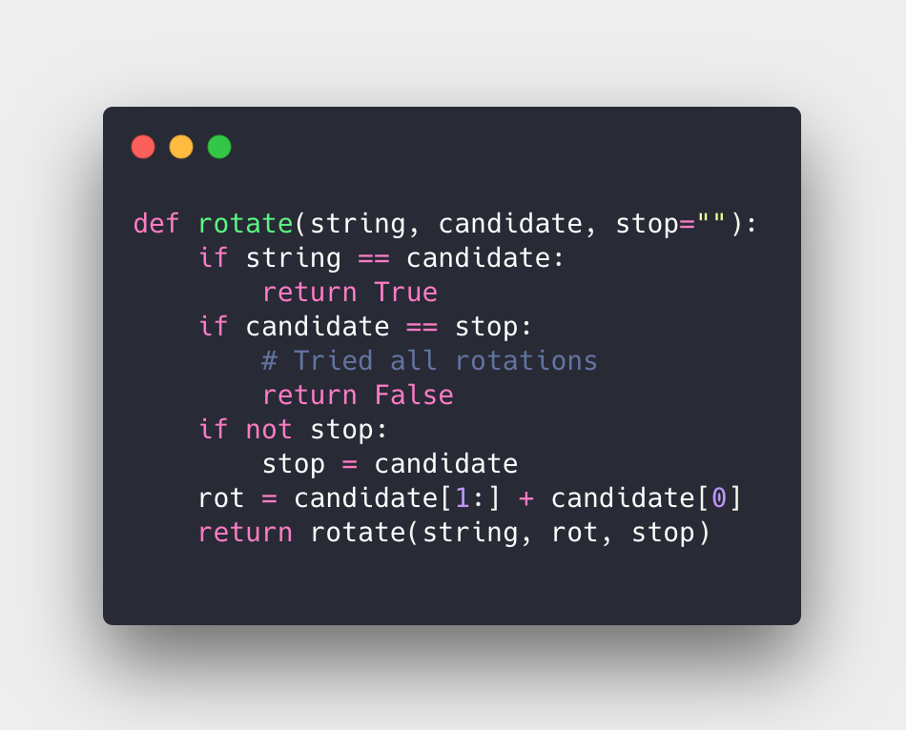
Solution #1
01
02
03
04
05
06
07
08
09
10
11
12
13
14
15
16
17
18
Notes:
What to Say:
What to Do:
Read the slide

Slide 39
Solution #1
Line 1 - Check if the candidate is the same as the string, if so then this is valid
Notes:
What to Say:
What to Do:
Read the slide

Slide 40
Solution #1
Line 3 - Stop means that we’ve rotated the whole string on it self, we have no more combinations
Notes:
What to Say:
What to Do:
Read the slide

Slide 41
Solution #1
Line 6 - If stop is empty, then set it to be the candidate (so we know when to stop)
Notes:
What to Say:
What to Do:
Read the slide

Slide 42
Solution #1
Line 8 - Begin rotating the string using recursion.
Notes:
What to Say:
What to Do:
Read the slide

Slide 43
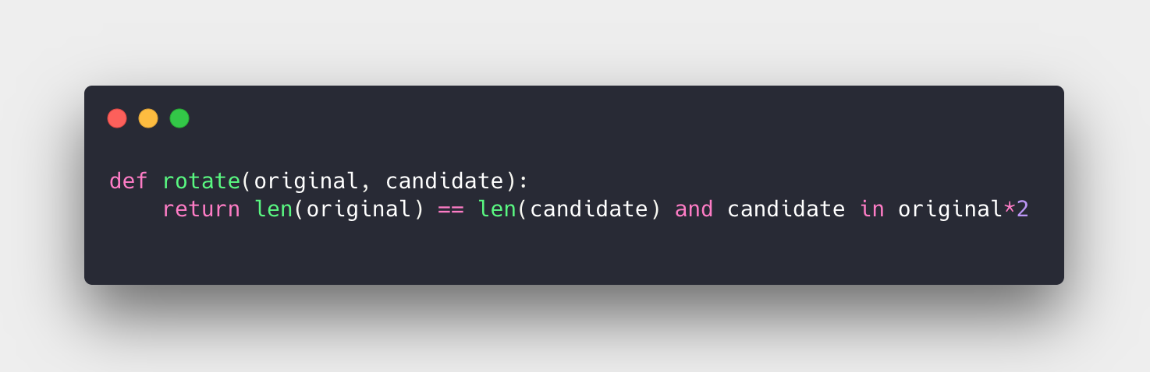
Solution #2
Notes:
What to Say:
What to Do:
Read the slide

Slide 44
Solution #2
First to shortcut the algorithm we ensure the length are the same.
Next, we double the original string and check whether the candidate string is inside. Why do we need to double it?
Notes:
What to Say:
What to Do:
Read the slide

Slide 45
Why is Solution #2 Better?
Solution 2 is much more simple (only one line!)
Solution 2 does not require recursion
Solution 1 is very prone to human error
Solution 2 leverages Python’s built in API
Notes:
What to Say:
What to Do:
Read the slide.

Slide 46
Zig-Zag Arrays
Write a function that takes an array with distinct elements and sorts them in a zig-zag fashion. (ie
a < b > c < d > e < f)
Time: 35 minutes
01
02
03
04
05
06
07
08
09
10
11
12
## input
zigzag([4, 3, 7, 8, 6, 2, 1])
## output (can be different order)
[3, 7, 4, 8, 2, 6, 1]
## input
zigzag([1, 4, 3, 2])
## output (can be different order)
[1, 4, 2, 3]
01
02
03
04
05
06
07
08
09
Notes:
What to Say:
Any questions that you have about these problems should be answered in the interviewer script.
If the answer is NOT in the interview script, the interviewer gets to decide the correct answer and the candidate should treat it as fact.
What to Do:
Read the slide.
Ask if everyone is ready to begin.
Keep time! If you are not diligent about the time, it will absolutely run over, especially if participants are stuck.

Slide 47
Time's Up!
Does anyone want to share their solution?
Share your repl.it URL and then we'll discuss!
Max time: 5 minutes
Notes:
What to Say:
Time's up! Let's share some solutions.
What to Do:
Ask if anyone wants to share their solution.
If they do, open another browser tab and navigate to the URL they share with you.
Encourage them to explain their solution and for participants to discuss!
Max time per solution: 5 minutes.

Slide 48
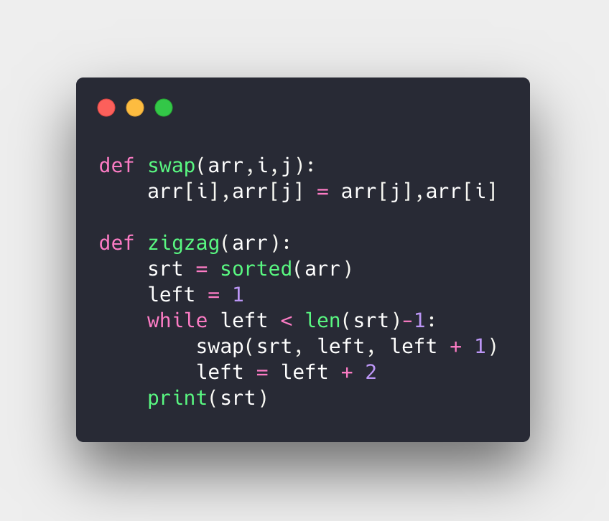
Solution #1
Notes:
Solution adapted form https://coderbyte.com/algorithm/generate-n-primes-sieve-of-eratosthenes-algorithm
What to Say:
What to Do:
Read the slide

Slide 49
Solution #1
Swap function is a helper we can use to swap array elements
Notes:
Solution adapted form https://coderbyte.com/algorithm/generate-n-primes-sieve-of-eratosthenes-algorithm
What to Say:
What to Do:
Read the slide

Slide 50
Solution #1
Line 5 - is where we sort the array. We can use any sorting algorithm but assume nlogn complexity.
Notes:
What to Say:
What to Do:
Read the slide

Slide 51
Solution #1
Line 6-9 - Using a while loop, we can iterate through the sorted array started at index 1, we swap higher to lower and skip by two. This ensures that we have zig-zag arrays.
Notes:
What to Say:
What to Do:
Read the slide

Slide 52
Solution #1
This is a very simple approach but what is the complexity?
(nlogn because of sorting)
Notes:
What to Say:
What to Do:
Read the slide

Slide 53
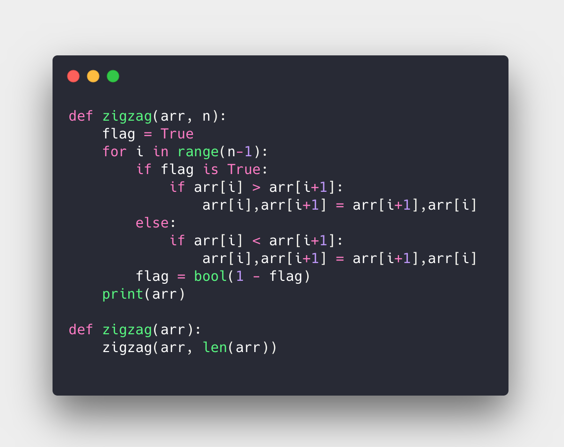
Solution #2
Notes:
What to Say:
What to Do:
Read the slide

Slide 54
Solution #2
Line 2: Flag true indicates relation "<" is expected, else ">" is expected. The first expected relation is "<"
01
02
03
04
05
06
07
08
09
10
11
12
13
14
15
16
17
18
Notes:
What to Say:
What to Do:
Read the slide

Slide 55
Solution #2
The for-loop iterates through the array, but what does it do?
01
02
03
04
05
06
07
08
09
10
11
12
13
14
15
16
17
18
Notes:
What to Say:
What to Do:
Read the slide

Slide 56
Solution #2
The for loop checks the flag and sees what relation is needed.
01
02
03
04
05
06
07
08
09
10
11
12
13
14
15
16
17
18
Notes:
What to Say:
What to Do:
Read the slide

Slide 57
Solution #2
Line 5 checks to see if the number at position i + 1 is not the intended flag, if it that is true then swap the numbers.
01
02
03
04
05
06
07
08
09
10
11
12
13
14
15
16
17
18
Notes:
What to Say:
What to Do:
Read the slide

Slide 58
Solution #2
Line 8 does the same thing as Line 5 but for the opposite relation
01
02
03
04
05
06
07
08
09
10
11
12
13
14
15
16
17
18
Notes:
What to Say:
What to Do:
Read the slide

Slide 59
Solution #2
Line 10 flips the relation so that we can zig-zag.
01
02
03
04
05
06
07
08
09
10
11
12
13
14
15
16
17
18
Notes:
What to Say:
What to Do:
Read the slide

Slide 60
Why is Solution #2 Better?
Solution 2 does not require O(nlogn) sorting
Solution 2 iterates through the array only once
Solution 2 has complexity of O(n)
Solution using O(1) memory (auxiliary space)
Notes:
What to Say:
What to Do:
Read the slide.

Slide 61
Pythagorean Triplet
Write a function that takes an array of elements and returns “Yes” if there is a pythagorean triplet ((a, b, c) that satisfies a² + b² = c²), “No” otherwise.
Time: 35 minutes
01
02
03
04
05
06
07
08
09
10
11
12
## input
triplet([3, 1, 4, 6, 5])
## output
Yes
## input
triplet([10, 4, 6, 12, 5])
## output
No
01
02
03
04
05
06
07
08
09
Notes:
What to Say:
Any questions that you have about these problems should be answered in the interviewer script.
If the answer is NOT in the interview script, the interviewer gets to decide the correct answer and the candidate should treat it as fact.
What to Do:
Read the slide.
Ask if everyone is ready to begin.
Keep time! If you are not diligent about the time, it will absolutely run over, especially if participants are stuck.

Slide 62
Time's Up!
Does anyone want to share their solution?
Share your repl.it URL and then we'll discuss!
Max time: 5 minutes
Notes:
What to Say:
Time's up! Let's share some solutions.
What to Do:
Ask if anyone wants to share their solution.
If they do, open another browser tab and navigate to the URL they share with you.
Encourage them to explain their solution and for participants to discuss!
Max time per solution: 5 minutes.

Slide 63
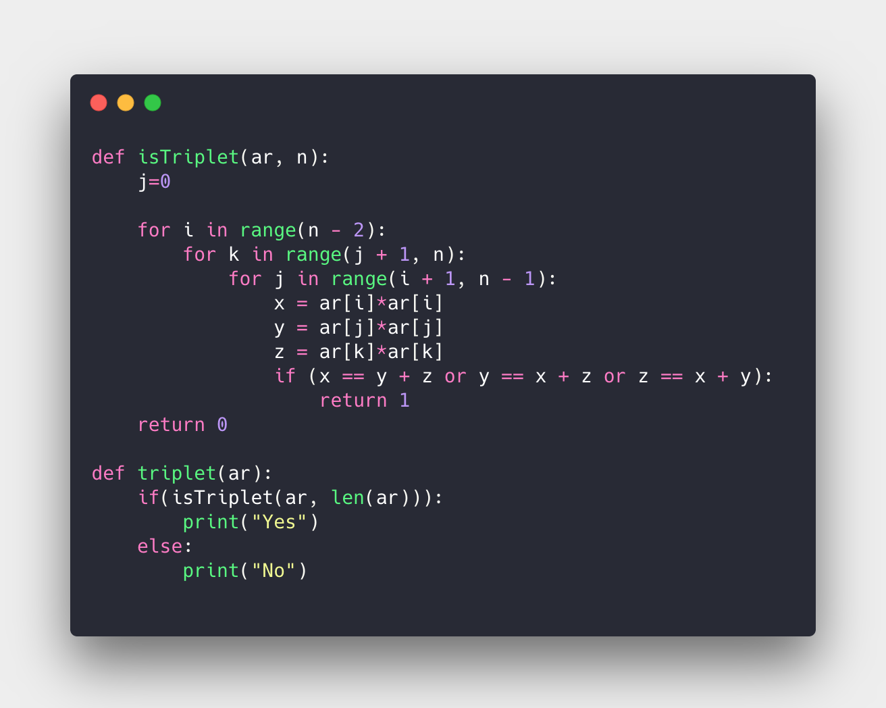
Solution #1
01
02
03
04
05
06
07
08
09
10
11
12
13
14
15
16
17
18
Notes:
What to Say:
What to Do:
Read the slide

Slide 64
Solution #1
Naive method - create 3 for loops and try all the possible combinations
01
02
03
04
05
06
07
08
09
10
11
12
13
14
15
16
17
18
Notes:
What to Say:
What to Do:
Read the slide

Slide 65
Solution #1
Line 7-9 - is where we calculate the square of each number
01
02
03
04
05
06
07
08
09
10
11
12
13
14
15
16
17
18
Notes:
What to Say:
What to Do:
Read the slide

Slide 66
Solution #1
Line 10 - is where we check whether the pythagorean trip
01
02
03
04
05
06
07
08
09
10
11
12
13
14
15
16
17
18
Notes:
What to Say:
What to Do:
Read the slide

Slide 67
Solution #1
Line 11 - if we reached here then we couldn’t find a pythagorean triplet
01
02
03
04
05
06
07
08
09
10
11
12
13
14
15
16
17
18
Notes:
What to Say:
What to Do:
Read the slide

Slide 68
Solution #1
What is the complexity?
O(n³)
Can we do better?
01
02
03
04
05
06
07
08
09
10
11
12
13
14
15
16
17
18
Notes:
What to Say:
What to Do:
Read the slide

Slide 69
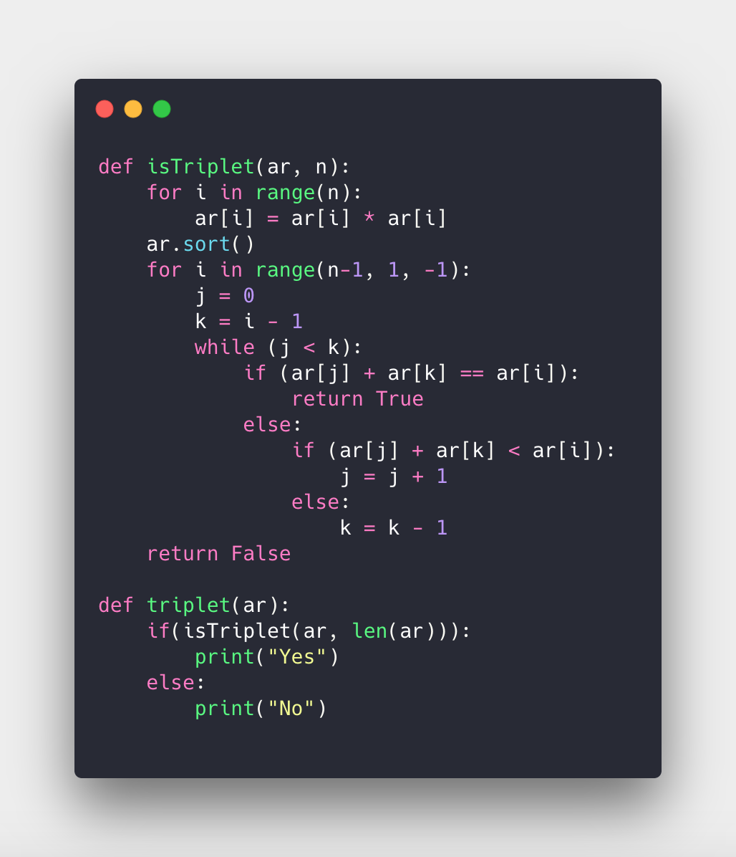
Solution #2
01
02
03
04
05
06
07
08
09
10
11
12
13
14
15
16
17
18
Notes:
What to Say:
What to Do:
Read the slide

Slide 70
Solution #2
Steps:
Square every element
Sort the squared array
Start with last element, and try to find two numbers in the array that add up to this one.
If none, move one index back, try again.
Notes:
What to Say:
What to Do:
Read the slide

Slide 71
Solution #2
Line 2 - is where we generate new array of squared numbers
Notes:
What to Say:
What to Do:
Read the slide

Slide 72
Solution #2
Line 3 - sort the squared array
Notes:
What to Say:
What to Do:
Read the slide

Slide 73
Solution #2
Line 4 - Start at the last element and go backwards in the array until index 2
Notes:
What to Say:
What to Do:
Read the slide

Slide 74
Solution #2
Line 5-6 - Select two numbers at the corner of the constrained array and start checking if they add up to number at index i.
Notes:
What to Say:
What to Do:
Read the slide

Slide 75
Solution #2
Line 8 - A triplet is found
Notes:
What to Say:
What to Do:
Read the slide

Slide 76
Solution #2
Line 10 - if a triplet is not found, check if the addition of the two squared numbers is less than the one at index i, then move the left index up one.
Notes:
What to Say:
What to Do:
Read the slide

Slide 77
Solution #2
Line 16 - if we reached here then a triplet could not be found.
Notes:
What to Say:
What to Do:
Read the slide

Slide 78
Why is Solution #2 Better?
Solution 2 has complexity of O(n²) compared to O(n³) for Solution 1
On average, Solution 2 finds triplets faster than Solution 1 since it leverages sorting
Notes:
What to Say:
What to Do:
Read the slide.

Slide 80
What did you learn today?
1
It's good to ask questions!
2
Plan your code in advance!
3
Your explanation is just as important as your solution.
Notes:
What to Say:
What to Do:
Read the slide.

Slide 81
What did you learn today?
We created a fun quiz to test your knowledge and see what you learned from this workshop.
http://mlhlocal.host/quiz
Notes:
What to Say:
What to Do:
Make sure they take the quiz and survey! We use this feedback to continually improve our workshops and to learn what content you're looking for!

Slide 83
Where to go from here
1
Check your email tomorrow for instructions on how to contribute your solution!
2
Check out mlhlocal.host/interview-cake for more practice problems.
3
Learn more about efficiency and Big O Notation at http://mlhlocal.host/big-o-notation
Notes:
What to Say:
Explain to participants what that learning shouldn't stop when the presentation ends!
What to Do:
Read the slide.

Slide 84

Sign up for the MLH Career Lab!
http://mlhlocal.host/career-lab
Browse a curated list of cool companies to work for.
Apply for jobs and internships from companies that want to recruit directly from the MLH community.
Receive updates and career advice from MLH!
Notes:
What to Say:
If you didn't sign up for the career lab during check-in, you can do so at anytime at the URL above!

Slide 85
Drop your resume with
By attending this workshop you have the opportunity to connect with a Citrix recruiter directly! Click on the button below to join the Citrix talent network.
Submit Resume
Notes:
What to Say:
Let students know they can drop their resume with Citrix and get connected to a recruiter directly!

Slide 86
Additional Practice Problem #1
Anagrams
Write a function that takes two inputs, a pair of strings, and proves if they are anagrams (contain all the same letters) of each other.
01
02
03
04
05
06
07
08
09
10
11
12
## input
anagram("dairy", "diary")
## output
TRUE
## input
anagram("cars", "face")
## output
FALSE
Notes:
What to Say:
Here is an additional problem you can try later!
What to Do:
Read the slide.

Slide 87
Additional Practice Problem #2
Vowel Counts
Write a function that takes a single input, a string, and return the counts of all the vowels.
01
02
03
04
05
06
07
08
09
10
11
12
## input
vowels("HELLO, WORLD!")
## output
{ E: 1, O: 2 }
## input
vowels("Major League Hacking")
## output
{ a: 3, e: 2, i: 1, o: 1, u: 1 }
Notes:
What to Say:
Here is an additional problem you can try later!
What to Do:
Read the slide.

Slide 88
Additional Practice Problem #3
Palindromes
Write a function that takes a single input, a string, and return if the string is a palindrome (reads the same backwards as forwards
01
02
03
04
05
06
07
08
09
10
11
12
## input
palindrome("racecar")
## output
TRUE
## input
palindrome("hacking")
## output
FALSE
Notes:
What to Say:
Here is an additional problem you can try later!
What to Do:
Read the slide.

Slide 89
Additional Practice Problem #4
Valid Parentheses
Write a function that takes a single input, a string, and return if the string has valid parenthesis (open brackets closed with closing brackets). Use ‘[{(‘ brackets.
01
02
03
04
05
06
07
08
09
10
11
12
## input
brackets("[[(M){L}[H]]]")
## output
TRUE
## input
brackets("(M[L)]{h}")
## output
FALSE
Notes:
What to Say:
Here is an additional problem you can try later!
What to Do:
Read the slide.

Slide 90

Learning shouldn't stop when the workshop ends...
Check your email for access to:
These workshop slides
Practice problems to keep learning
Deeper dives into key topics
Instructions to join the community
More opportunities from MLH!
Notes:
What to Say:
What to Do:
Read the slide.

Slide 91
v.0.0.2

